Slide 1
Data Flow Diagram (DFD)
Md. Mohsin Uddin, CSE, EWU

Slide 2
Data Flow Based Methods
Since a computer based system has to handle both data and logic, data is studied in the form of I/O of the system or as files.
It requires the development of Data Flow Diagram (DFD).
Developed in 1970’s by Coad and Constanvine, TOM De Marco, Page Jones and Myer.

Slide 3
DFD Elements, SYMBOLS, and definitions
Data Flow : It is nothing but the Data move in a specific direction from an origin to a destination in the form of a document, letter, telephone call, or virtually any other medium. The data flow is a “packet” of data.
Processes : The physical component of the process is not identified. We can define the processes as the people, procedures, or devices that use or produce or transform data.
OR

Slide 4
DFD Elements, SYMBOLS, and definitions
Source or destination of data : External sources or destinations of data, which may be people, programs, organizations, or other entities, interact with the system but are outside its boundary. The term source and sink are interchangeable with origin and destination, respectively.
Data store : The data store may represent computerized or non-computerized devices. Here data are stored or referenced by a process in the system.
OR

Slide 5
DFD Elements, SYMBOLS, and definitions
In a data flow diagram, each component is labeled with a descriptive name.
Process names are further identified with a number that will be used for identification purposes.
The number assigned to a specific process doesn’t represent the sequence of processes.
It is strictly for identification and will take on added value when we study the components that make up a specific process.

Slide 6
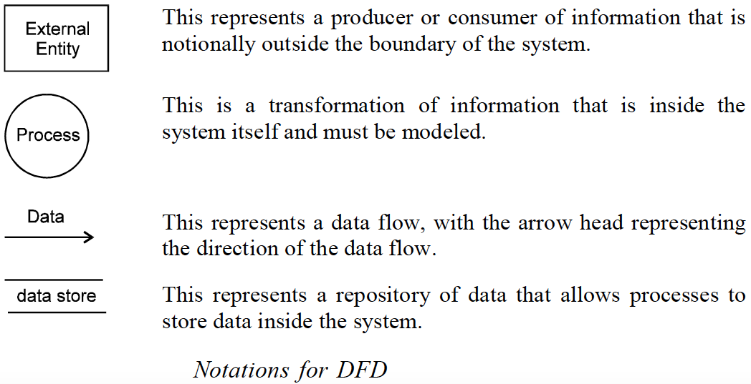

Slide 7
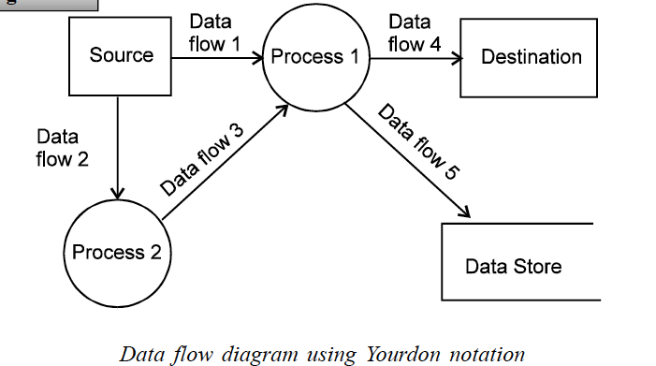
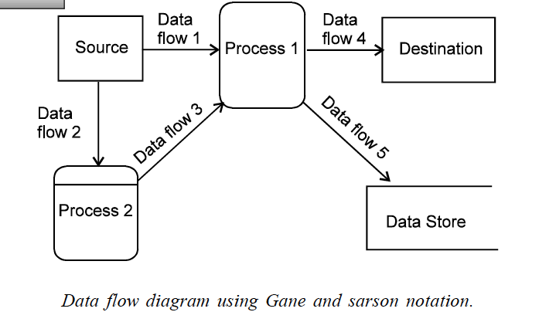
Sample dfds

Slide 8
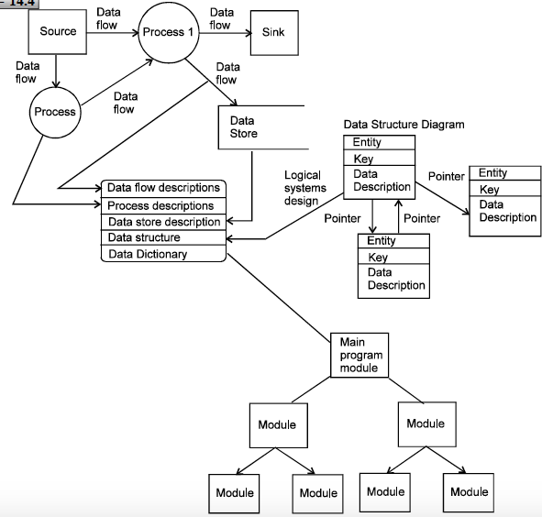
Fig. A Complete DFD

Slide 9
Leveling OF dfd
We can use the DFD, when we want to represent a system or a piece of software at any level of abstraction.
We can begin at the top-most level where only the bare minimal details of information flow and process details are found.
The DFD at this level may be called level 0 DFD and is referred to as the “Context Level DFD”.
In a DFD, processes are represented as bubbles (circles with the names of the processes or transformations).

Slide 10
Leveling OF dfd
A line represents a data flow with names of data items, with an arrowhead indicating the direction of flow.
The entire system is represented by just one process (and so one bubble) at level 0 DFD or the context level DFD.
In this, all data flows from and to the external entities are depicted.
External entities themselves are shown within rectangular boxes.

Slide 11
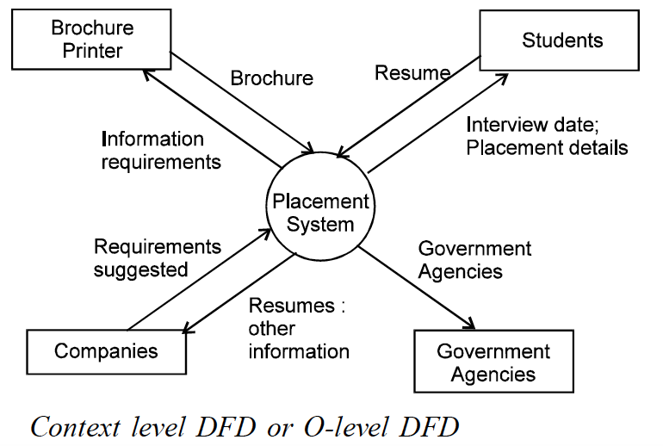
Level 0 DFD (context level DFD)
At this Level 0, the DFD just places the system in context and depicts external entities and basic data flows.
Consider a placement system on campus for a university. The level 0 DFD (context level DFD) is shown in the above figure.

Slide 12
Level 1 DFD
We can refine the level 0 DFD to a higher level, called the level 1 DFD.
The single process (bubble) representing the whole process is refined into further details involving other processes.
Level 1 DFD may contain 3 to 8 bubbles representing processes, with interconnecting arrows as data flows.
In addition, the level 1 DFD may also contain a “data store” which is a data repository i.e. to be stored for use by one or more processes.
The data store can represent something as a simple as a buffer, a queue, a flat file or even a sophisticated RDBMS.

Slide 13
Level 1 DFD (a placement system on campus for a university)
Universities arrange for companies to visit the campus, interview students and select them for employment. A placement officer prepares information material such as brochures, letters and profiles of potential candidates available for employment and sends them to companies. Some of these companies discuss with the placement office suitable dates for interviews, giving details about their activities, profiles of persons being arranged. Selected candidates are offered jobs. The company as well as the placement officer work with a mutually agreed upon set of policies.

Slide 14
Level 1 DFD
Level 1 DFD shows the important subsystems of the placement system.
It shows various processes and data flows.
The following are some of the main processes shown in this level 1 DFD.
Process 1 : Preparation of brochures and letters.
Process 2 : Invitation for interviews
Process 3 : Interview schedule
Process 4 : Selection of students

Slide 15
Level 1 DFD
Both the “Invitation for Interviews” and “Interview Schedule” processes access a data store called “Mail List”.
Processes “Interview schedule” and “Selection of Students” make use of the data store file-2 or the “Time schedule Register”.
In level 1 DFD, we show all the external entities as shown in level DFD.
Beyond level 1, it is conventional not to show external entities explicitly.
A convention used in DFD is to show only those data stores that are accessed by at least two processes.
However, if the analyst feels that a data store is very important, but is accessed only by one single process, it may be shown.

Slide 16
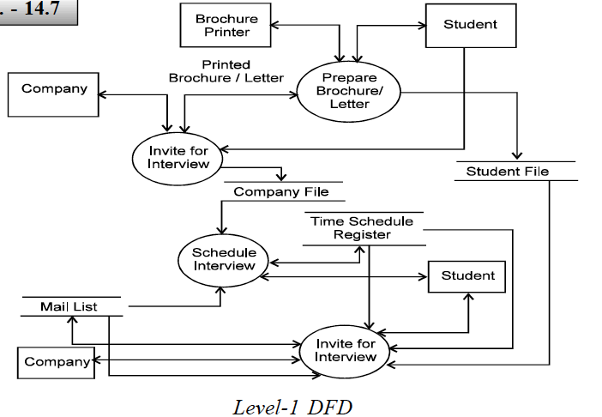
Level 1 DFD
Figure. The level 1 DFD for the same placement system on campus for a university.

Slide 17
Level 2 DFD
The external entities aren’t shown explicitly. Sometimes they can be shown implicitly by qualification with respect to the entity using “from” and “by”.
There must be some consistency among the incoming and outgoing arrows with the previous level (level 1 in this case).
The same processes in the previous level may appear, as they were, in this level too.
Processes in the previous level may be refined into more detailed processes and data flows.

Slide 18
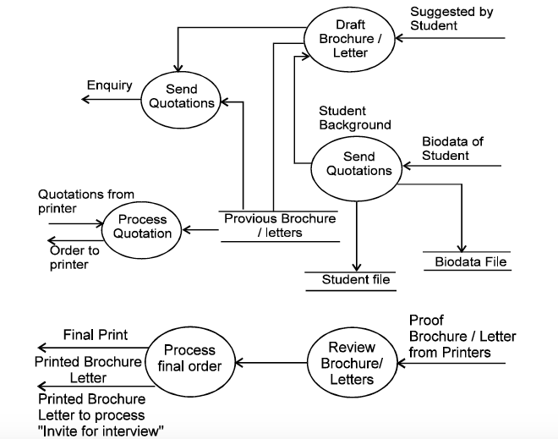
Level 2 DFD
Figure. The level 2 DFD for process 1, i.e. “Prepare Brochures and Letters”.

Slide 19
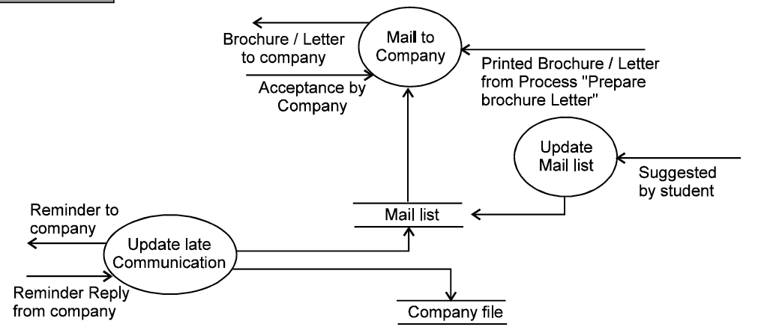
Level 2 DFD
Figure. The level 2 DFD for the process 2, i.e. “Invitation for Interview”.

Slide 20
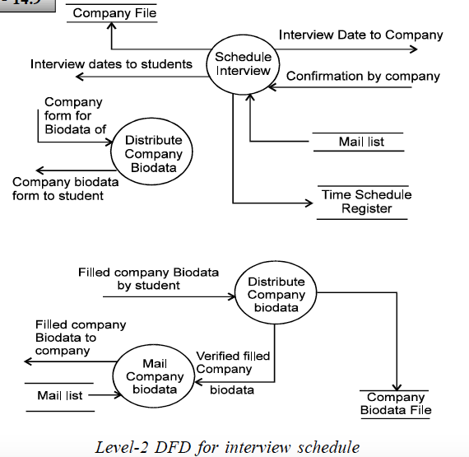
Level 2 DFD
Figure. The level 2 DFD for the process 3, i.e. “Interview schedule”. The Processes that are not further refined in higher levels are also called primitive processes.

Slide 21
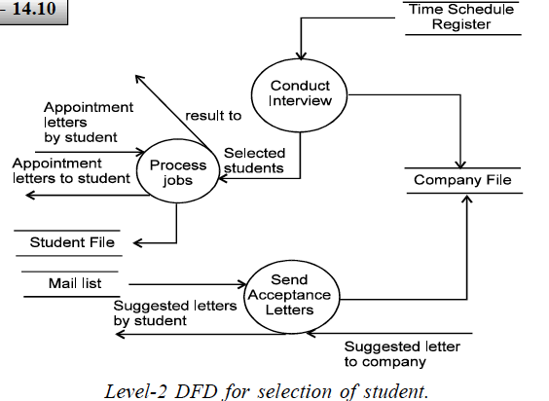
Level 2 DFD
Figure. The level 2 DFD for the process 4, i.e. “Selection of student”.

Slide 22
DFD Vs flowchart
Many beginners confuse a DFD with a flowchart. A DFD depicts information flow without explicit representation of things like conditions, loops, etc.
In other words, a DFD doesn’t depict procedure logic.

Slide 23
data dictionary or requirement dictionary
A basic DFD (even at multiple levels) is not sufficient to describe the requirements of software.
Arrows into and out of a process bubble represent data items that are input and output.
A data store represents some organized collection of data.
DFD does not depict the content of the data items.
To get this, we need to introduce another component called data dictionary or requirement dictionary.

Slide 24
data dictionary or requirement dictionary
A data dictionary is a catalog or a repository of the elements in a system.
As the name suggests, these elements center around data and the way they are structured to meet user requirements and organizations needs.
In a data dictionary you will find a list of all the elements such as data flows, data stores, and processes etc. for composing the data flowing through a system.
The dictionary is developed during data flow analysis and assists the analysts involved in determining systems requirements.

Slide 25
Why is a Data Dictionary Important ?
In order to manage the detail in large system.
In order to communicate a common meaning for all system elements.
In order to document the features of the system.
In order to facilitate analysis of the details in order to evaluate characteristics and determine where system changes should be made.
In order to locate errors and omissions in the system.
A data dictionary is a supplementary documents to be used with the DFD.

Slide 26
data dictionary
The following are part of the information recorded in a data dictionary.
Data flows and its components, i.e. input, output and intermediate data.
Data stores, like files
Processes
Any other relevant information that helps in writing the requirements specifications better.

Slide 27
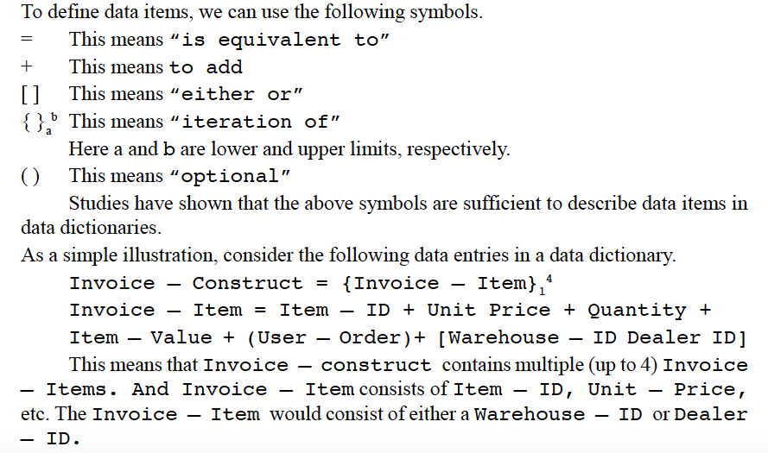

Slide 28
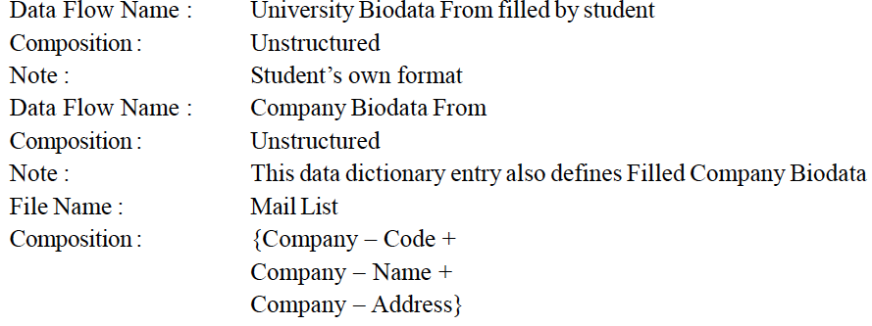
Sample data dictionary

